Slide 1
Unusual Trademarks in no particular order

Slide 2
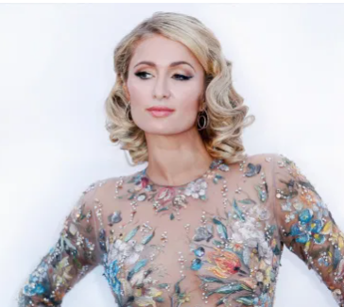
The phrase "That's hot"
Reality TV-star-turned-DJ Paris Hilton
decided to trademark her phrase “That’shot”.
She sued Hallmark for use of the phrase on a greeting card.

Slide 3
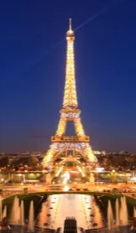
Photos of the Eiffel Tower at night
The tower itself is part of the public domain, but its lighting display is a separate work of art—and copyrighted.
If you did want to sell your nighttime image of the magnificent illumination, you would need to request permission from the Société d'Exploitation de la Tour Eiffel, which runs the famous landmark.

Slide 4
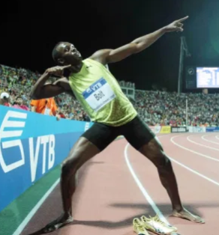
Usain Bolt's "lightning bolt" gesture
A gesture can be trademarked.
In addition to trademarking his name, runner Usain Bolt has trademarked his signature "lightning bolt" victory move.

Slide 5
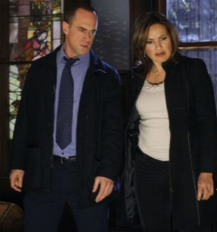
The Law & Order sound
That "dun dun" sound that precedes every episode of Law & Order was created by composer Mike Post, and its trademark is owned by NBCUniversal Media.

Slide 6
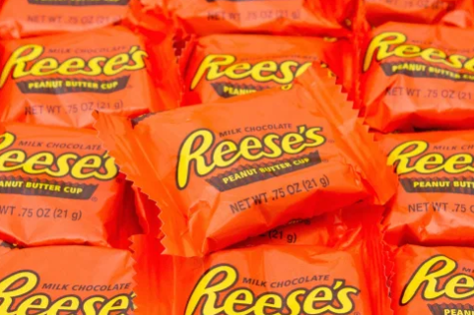
Reese's orange
The orange color on the peanut butter cup's packaging is not on any other food wrapper.
Reese's wrappers clearly state the "orange background color is a registered trademark."

Slide 7
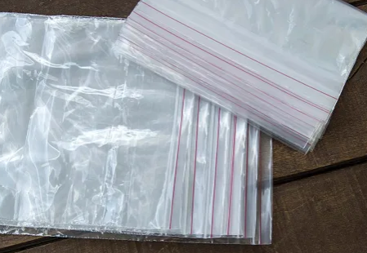
The word "baggies"
"Baggies" is a registered trademark of the Pactiv Corporation, which owns Hefty and is a subsidiary of Reynolds Group Holdings—the folks behind Reynolds Wrap.

Slide 8
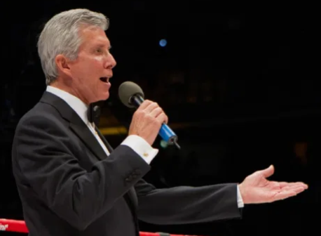
The phrase "Let's get ready to rumble"
Boxing and wrestling announcer Michael Buffer knew he had a good idea on his hands when he came up with the phrase "Let's get ready to rumble!"
Buffer trademarked the phrase in 1992 and has reportedly made more than $400 million from licensing its use in the decades since.

Slide 9
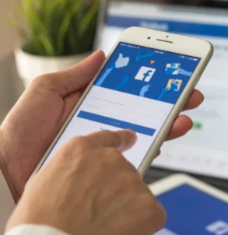
The word "face"
While staking claim to the word "face" might seem like overkill, that's exactly what Mark Zuckerberg managed to do following the success of Facebook.
The word "face" is now a trademark of Facebook, but only when applied by potential social media competitors.

Slide 10
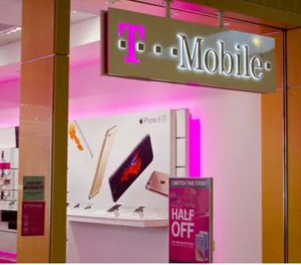
T-Mobile magenta
That bright pink on the signage at your local T-Mobile store is more than just a pretty color.
T-Mobile, the telecom giant has issued cease-and-desists to multiple companies for using it without their permission.

Slide 11
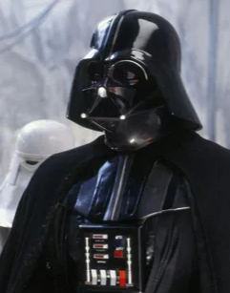
The sound of Darth Vader's breathing
You can even trademark the sound of someone's breath.
Lucasfilm has trademarked Anakin Skywalker's famous under-the-helmet inhale and exhale—which was created by breathing through a scuba regulator.

Slide 12
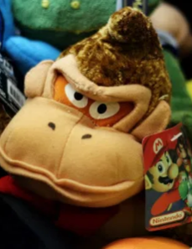
The phrase "It's on like Donkey Kong"
Donkey Kong is a Nintendo trademark.
"It's on like Donkey Kong," a phrase popular among '90s TV characters and sorority girls getting ready to spar, is also trademarked by Nintendo.

Slide 13
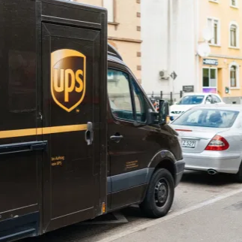
UPS brown
The chocolate brown shade—formally known as "Pullman brown"—is one of the company's many trademarks.

Slide 14
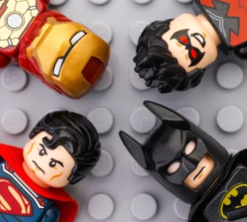
The term "superhero"
The term "superhero" is a trademarked phrase.
It is co-owned by long-time rivals Marvel and DC Comics.

Slide 15
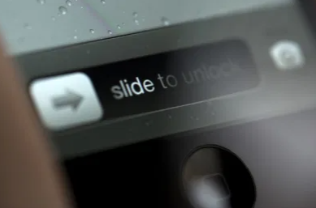
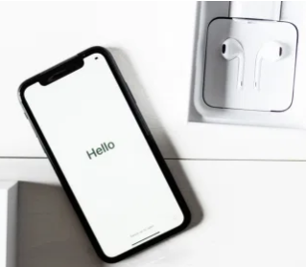
Apple's slide-to-unlock function
The slide-to-unlock used to unlock previous versions of the iPhone is patented by Apple.
Apple sued Samsung for $119.6 million for using a similar function and won the decision.
The "chime" sound on its devices
Apple trademarks everything associated with their products even the sounds they make.

Slide 16

The term "realtor"
This term is frequently used as a synonym for a real-estate agent. "realtor" is a trademarked term
owned by the National Association of Realtors might just come calling.

Slide 17
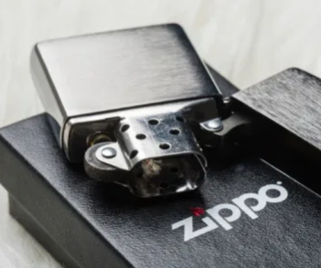
Zippo's click sound
That satisfying sound you hear when you flick open a Zippo lighter.
The brand says the sound is so specific to their products that they secured a trademark for it in 2018.

Slide 18
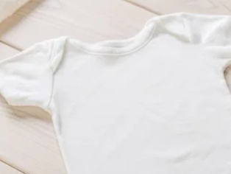
The word "onesie"
"onesie", a generic term for a baby's one-piece garment is the trademarked property of the Gerber Childrenswear Company.

Slide 19
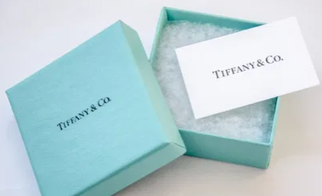
Tiffany blue
While it's often imitated, that widely recognized shade of blue is specific to the jewelry giant and legally trademarked.

Slide 20
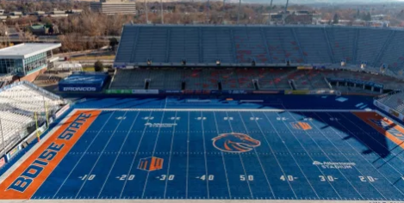
Boise State's blue football field
The blue turf is a signature of Boise State University's football stadium—in addition to being the first school to have a non-green field, they also have a trademark on the turf.

Slide 21
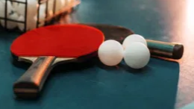
Ping-pong
Ping-pong is trademarked by games company Parker Brothers

Slide 22
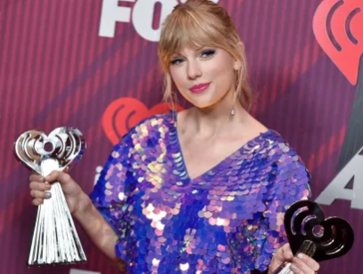
The phrase "This sick beat"
Taylor Swift trademarked the phrase "this sick beat" from her hit single "Shake It Off," as well as "Nice to meet you, where you been?" and a handful of other utterances from her album 1989.

Slide 23
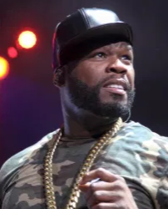
Rapper 50 Cent's name
The rapper even sued Taco Bell for using his name and image in an advertisement that suggested he change his moniker to 79 Cent, 89 Cent, or 99 Cent in exchange for a donation to the charity of his choice.

Slide 24
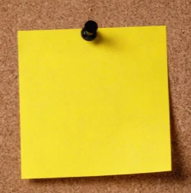
Post-It yellow
The Post-It's specific shade of yellow is only on office supplies made by it's parent company 3M.

Slide 25
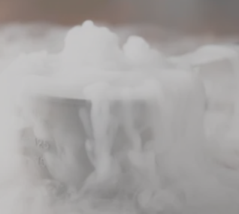
Dry ice
Referring to solid carbon dioxide as "dry ice," uses a term that had been the trademark of the Dry Ice Corporation of America from 1925 to 1989, when it officially expired.

Slide 26
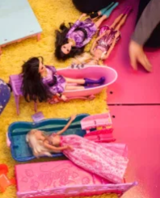
Barbie pink (Pantone 219C)
Barbie is a trademarked name, and her favorite color is also legally protected and owned by Mattel.
The brand sued RCA Records for using the color in the packaging for Aqua's single "Barbie Girl"—the song's title and lyric also got the band in hot water.

Slide 27
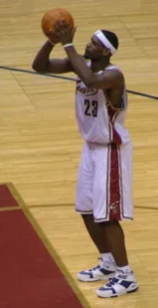
The phrase "Just a kid from Akron"
LeBron James has staked claim on a number of his signature phrases
most notably: "Just a kid from Akron."

Slide 28
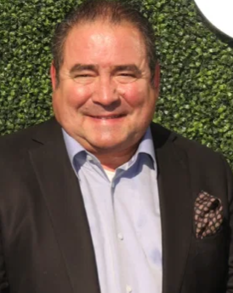
The word "Bam!"
Celebrity chef, Emeril Lagasse's signature shout is trademarked as it relates to kitchenware.

Slide 29
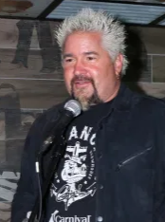
Guy Fieri's name
Food Network star Guy Fieri trademarked his name under International Class 30, meaning you can't use his moniker in association with virtually any food product.
He also owns the phrase "flavor town“.

Slide 30
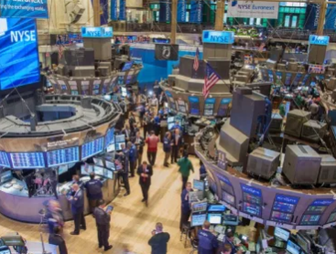
The New York Stock Exchange bell ring
The bell's iconic clang is is owned by the NYSE, as are the capitalized versions of the phrases: "Opening Bell" and "Closing Bell."
https://bestlifeonline.com/surprising-copyright/

Slide 31
Unusual Copyright Claims
https://listverse.com/2018/07/15/top-10-craziest-copyright-claims-ever-made/

